Slide 1
Stoicism & Meditations
The guide to mental strength and peace !!

Slide 2
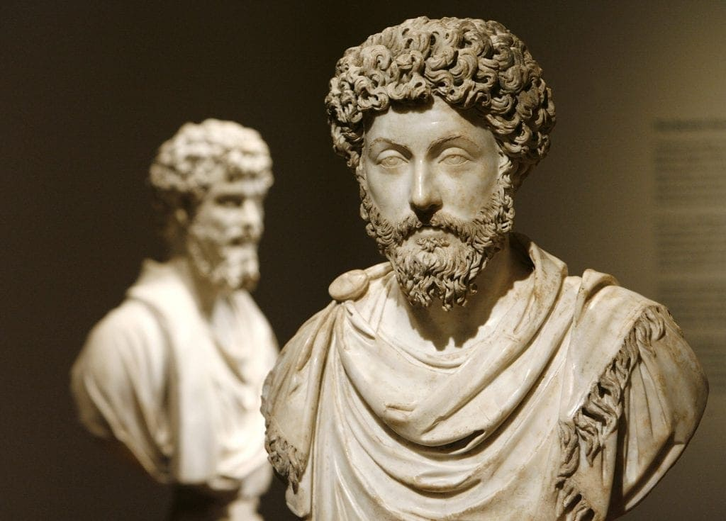
What is Stoicism ?
The Hellenistic philosophy that flourished in ancient Rome and Greece
Teaches about clear thinking, virtue, peace of mind, individual freedom etc.,
Famous personalities include Marcus Aurelius, Epictetus, Seneca, Epicurus and so on.
Benefits and is relevant even today
Famous books are the Meditations, Letter from a stoic, The Daily Stoic etc.,

Slide 3
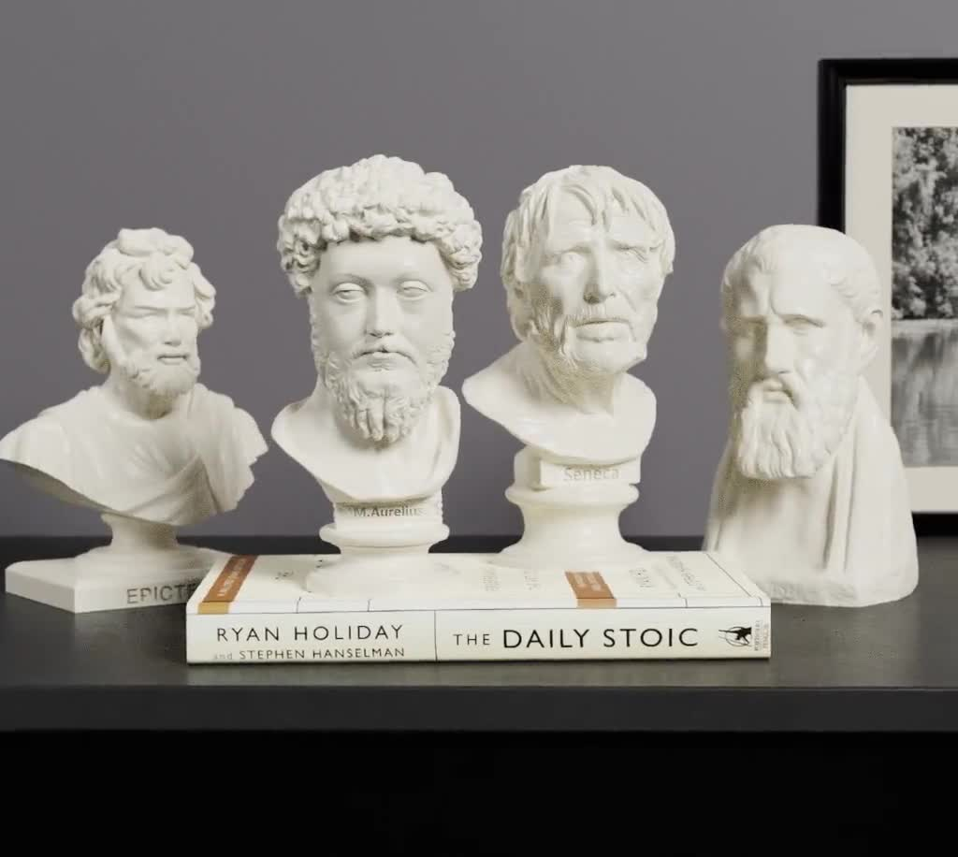

Slide 4



Slide 5

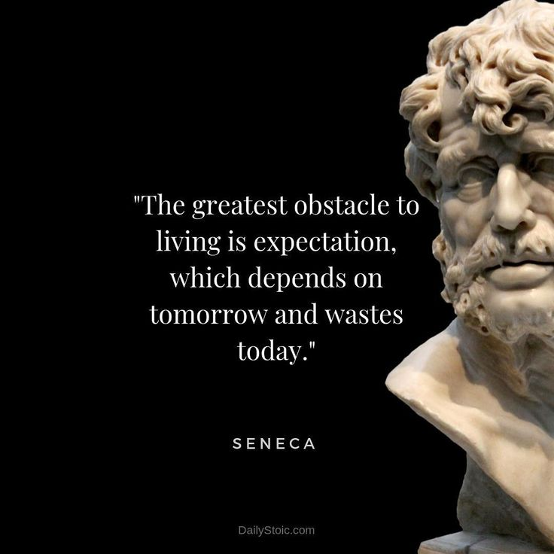

Slide 6
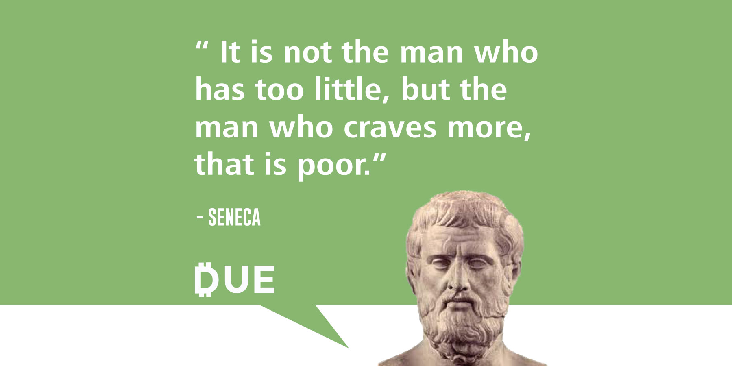


Slide 7
